Slide 1

Investigating the Use of Omnifold in Unfolding Jet Transverse Momenta
By Simon Browning of Abilene Christian University
for the STAR Collaboration
This research was supported by US DOE MENP Grant DE-FG02-03ER41243.

Slide 2
Abstract - Summary
Detector effects distort information, requiring data to be “unfolded”.
Correcting for effects becomes challenging with steeply-falling spectra.
Iterative Bayesian Unfolding (IBU) is well-established but requires data to be binned.
Omnifold is a new method that uses machine learning to unfold data event-by-event.
Investigate Omnifold’s ability to recover true distributions.

Slide 3
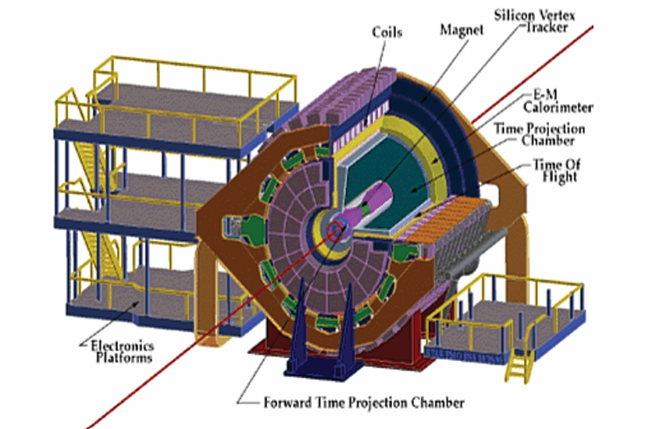
The STAR Experiment
Studies the strong interaction between subatomic particles.
Housed at BNL
Focuses on studying proton spin and the quark-gluon plasma (QGP).
Jet analysis requires the unfolding of multiple observables simultaneously.
Difficult to do with traditional/fixed-bin unfolding techniques.

Slide 4
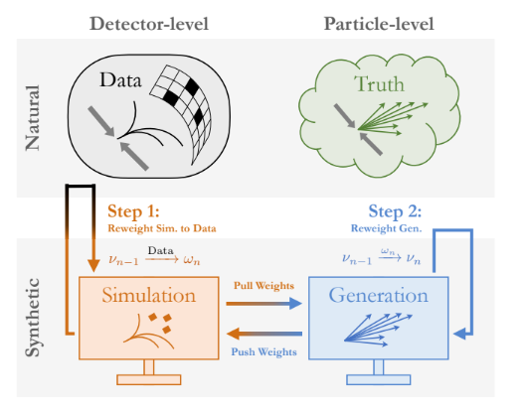
What is Omnifold?
A machine-learning based algorithm.
A non-fixed-bin unfolding method.
Deals with natural and Monte Carlo synthetic data sets.
Each data set contains detector-level and particle-level data.
Keras neural network classifier.
Andreassen, Anders, et al., Omnifold: A Method to Simultaneously Unfold All Observables, 2019.

Slide 5
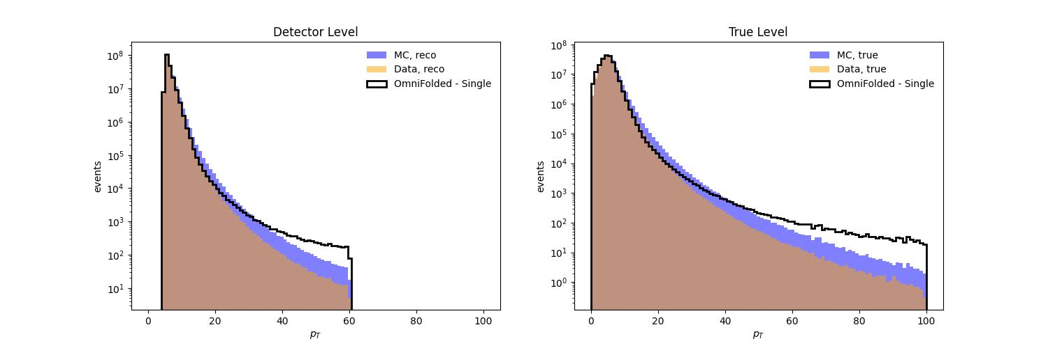
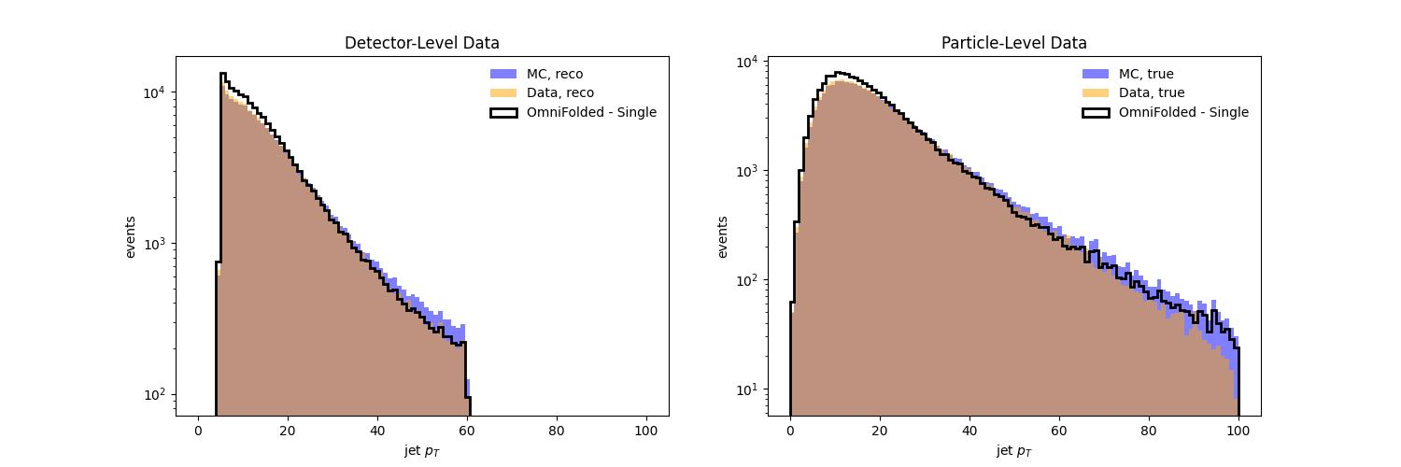

Steeply Falling Spectra
Counts vs. Transverse Jet Momentum [GeV]
We seek to generate data that approximates steeply-falling jet $p_{T}$ spectra.
Test data generated via fast Monte Carlo based on STAR run 11 detector simulation.
Generating the low-statistics tails of steeply falling spectra is numerically expensive.
We generate less steeply-falling data and then reweight to better reproduce observed jet $p_{T}$ spectra.
We apply Omnifold to each distribution to test sensitivity to steepness of the spectra.
Better performance on less steep spectra.

Slide 6
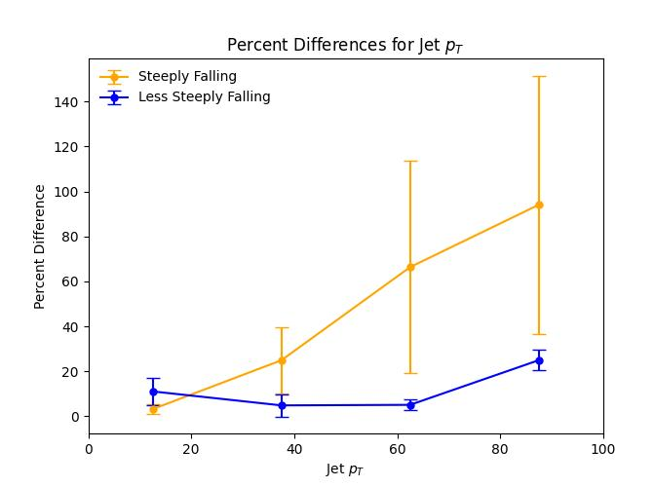
Steeply Falling Spectra
We add all events in 25 GeV bins and compare the true spectra to the unfolding.
Averages and standard deviations calculated from 5 tests.
Consistently fits low momenta well.
  High statistics/weight.
Struggles fitting the high momenta tail.
  Low statistics/weight.
Better performance with less steep spectra.

Slide 7
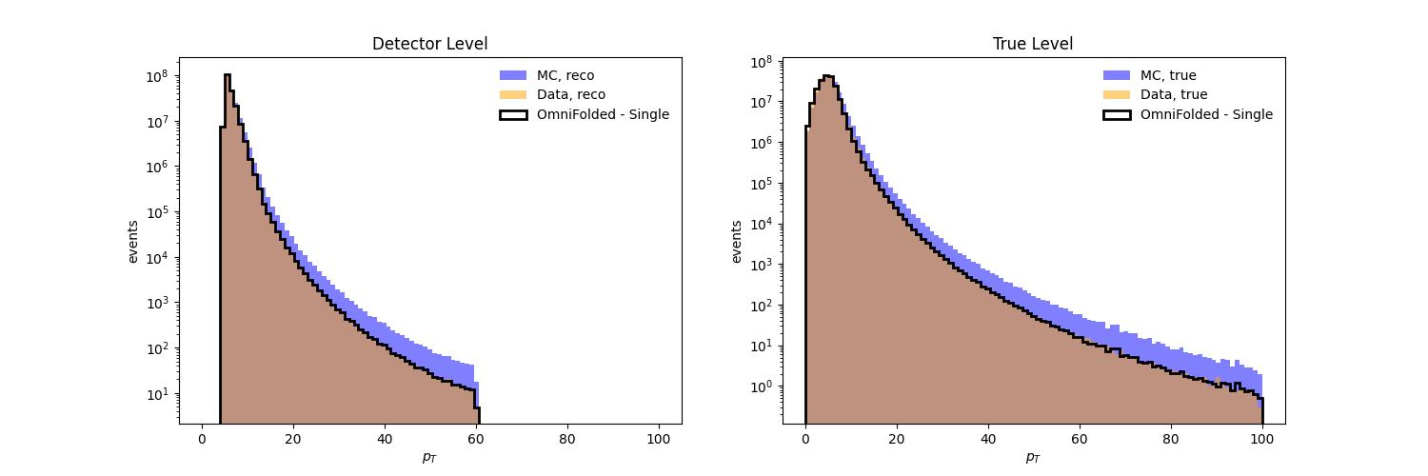
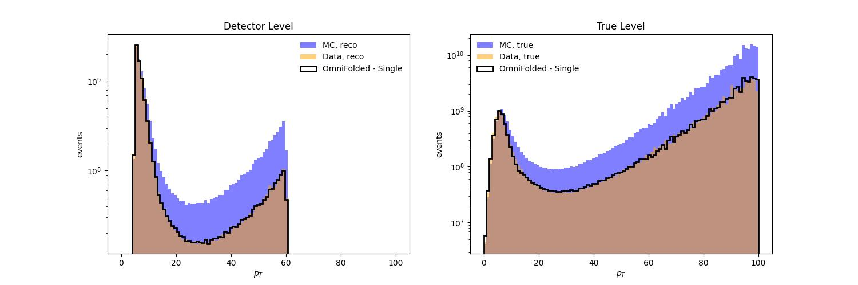

Custom Weights
Omnifold treats low momenta with more importance.
How can we make Omnifold treat the tail with more importance?
Give Omnifold event weights modified by a custom weighting function.
Rescales weights to minimize the discrepancy between high and low momenta.
$$Weight_{new}=Weight_{old}exp⁡(p_{T}^{0.68})$$

Slide 8
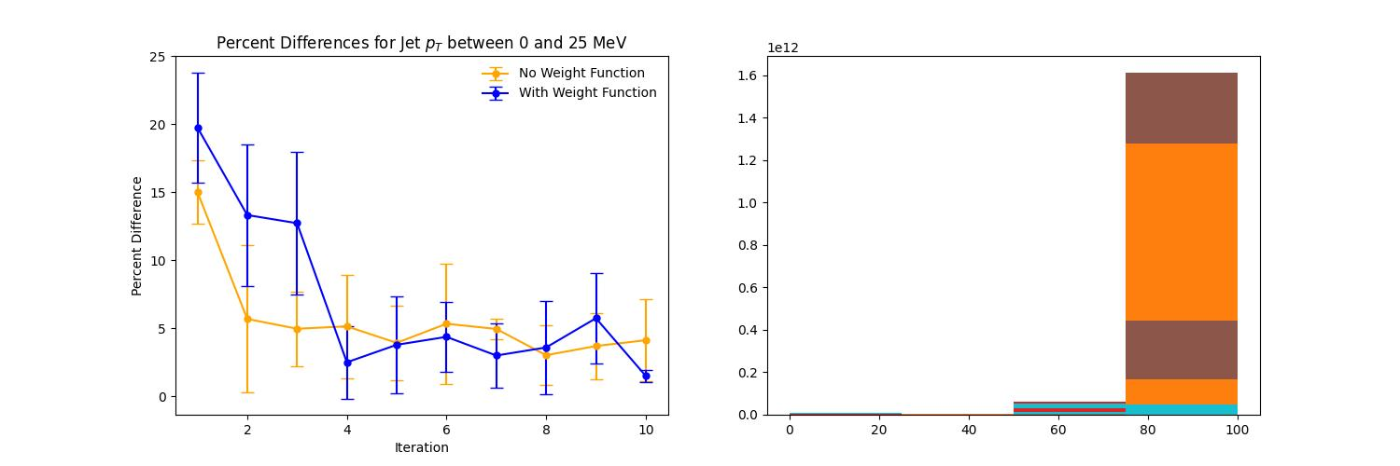
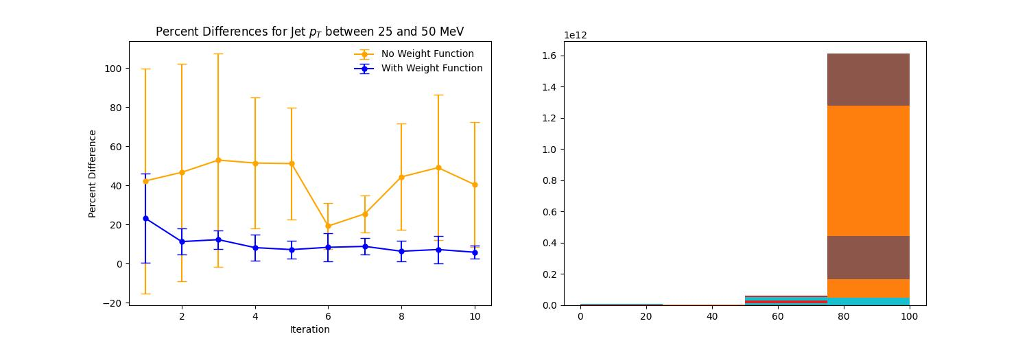
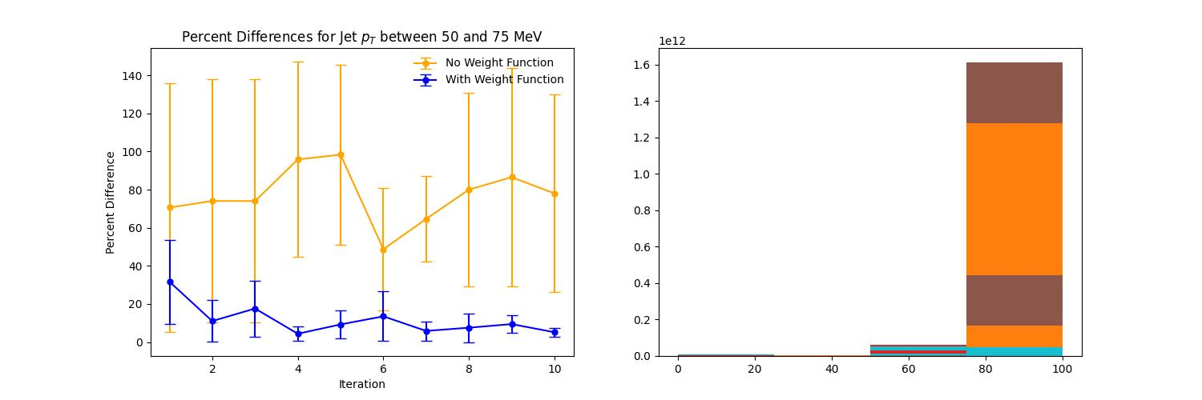

Results
Averages and standard deviations calculated from 5 tests.
Percent Differences for jet $p_{T}$ between 0 and 25 GeV
Percent Differences for jet $p_{T}$ between 25 and 50 GeV
Omnifold consistently fitted custom-weighted spectra more effectively.
Lower average percent error and standard deviation than unaltered steeply falling spectra.
Percent Differences for jet $p_{T}$ between 50 and 75 GeV
Percent Differences for jet $p_{T}$ between 75 and 100 GeV

Slide 9
Future Work
Reweighting function must be custom made for each data set.
Find a reliable data fitting routine for steeply falling spectra.
Allows us to solve for the best reweighting function.
Investigation into uncertainty and error that this approach causes.

Slide 10

Acknowledgements
Special thanks to:
- Dr. Joseph Atchison
- Dr. Jim Drachenberg
- The Department of Energy
The ACU Nuclear Physics Research Group
The STAR Collaboration
This research was supported by US DOE MENP Grant DE-FG02-03ER41243.

Slide 11
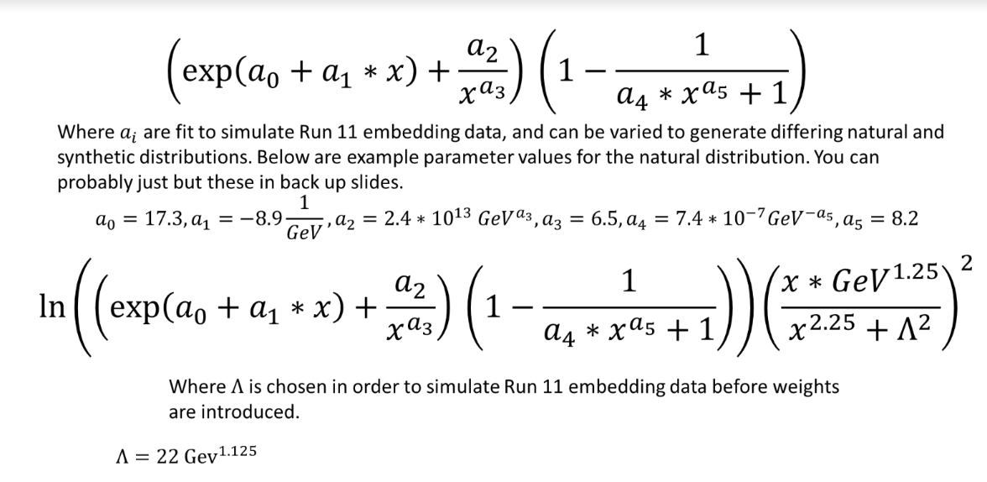
Steeply Falling Spectra

